Slide 1
INFSCI 2500 Lecture 5 Linked Lists

Slide 2
Today’s Plan
HW2 Review
Understand what a Singly and Doubly LinkedList is
Understand the differences between ArrayLists and LinkedLists
Understand when to use LinkedLists vs ArrayLists
HW3 Assign

Slide 3
HW2 Review

Slide 4
What is a LinkedList
Java Collections Framework
Implements List interface
Paramaterized
No random access
Non sequential storage
Constant time insertion/deletion

Slide 5
What is a LinkedList
List is comprised of Entries
Each entry has a reference (link)
Points to next entry
Points to previous entry (2 links)

Slide 6
SinglyLinkedList
Less powerful, simplified version
Not in Java Collections Framework
We will build it together

Slide 7
Entries
protected class Entry<E>{
protected E element; //element
protected Entry<E> next; //link
}
Element is the “payload”
Nested within SinglyLinkedList
Direct field access

Slide 8
SinglyLinkedList Fields
protected Entry<E> head; //reference to the first entry

Slide 9
SinglyLinkedListMethods
Implementing List means a lot of methods
Most will be undefined for this demo
public SinglyLinkedList()
public boolean isEmpty()
public boolean add(E element)
public int size()
public boolean contains(Object obj)

Slide 10
public SinglyLinkedList()
public SinglyLinkedList(){
head=null;
}
Creates empty SinglyLinkedList
Initialize head to null

Slide 11
public boolean isEmpty()
public boolean isEmpty(){
return head==null;
}
Head points to nothing? No elements.

Slide 12
public boolean add(E element)
public boolean add(E element){
Entry<E> newEntry = new Entry<E>();
newEntry.element=element;
newEntry.next=head;
head=newEntry;
return true;
}
Adds to the front of the list.

Slide 13
public int size()
int count=0;
for(Entry<E> current = head; current!=null; current=current.next){
count++;
}
return count;
O(n), no size field

Slide 14
public boolean contains(Object obj)
public boolean contains(Object obj){
if(obj==null){
for(Entry<E> current=head;current!=null;current=current.next){
if(current.element==null){
return true;
}
}
}
else {
for(Entry<E> current=head;current!=null;current=current.next){
if(obj.equals(current.element)){
return true;
}
}
}
return false;
}
Special case for obj == null first to avoid null pointer exception in obj.equals()

Slide 15
Differences Already
Linked structure
Size of underlying data structure not needed in advance
Adding done in O(1)
No Random Access
Selection done in O(n)

Slide 16
SinglyLinkedListIterator
For use by user
for loops in contains,size directly access fields
No good!
List interface provides iterator()
Build iterator class ourselves
User gets iterator from SLL object

Slide 17
SinglyLinkedListIterator
protected class SinglyLinkedListIterator implements Iterator<E>{
protected Entry<E> next; //only field
Methods
public SinglyLinkedListIterator() //constructor
public boolean hasNext() //is there a next entry?
public E next() //give me the next entry

Slide 18
public SinglyLinkedListIterator()
public SinglyLinkedListIterator(){
next=head;
}
Assigns the iterator’s next field to the List’s head field
Nested class, direct access.

Slide 19
public boolean hasNext()
public boolean hasNext(){
return next!=null;
}
Is the reference stored in the iterator’s next field null?
If yes, end of list.

Slide 20
public E next()
public E next(){
E theElement = next.element;
next=next.next;
return theElement;
}
next.element is the ‘payload’ of the entry. Store it in a paramaterized object
Then set the iterator next field equal to the next field of the list’s entry being pointed at currently
Then return the object obtained

Slide 21
SinglyLinkedListIterator
Meanwhile, back inside SinglyLinkedList class
public Iterator<E> iterator() {
return new SinglyLinkedListIterator();
}

Slide 22
SinglyLinkedList Example
SinglyLinkedList.java

Slide 23
DoublyLinkedList
Linked List with references to previous and next entries
Java Collections Framework – LinkedList class
Implements List interface – index based methods
Much more robust than SinglyLinkedList
Searching is O(n)
Inserting/deleting is O(1)

Slide 24
LinkedList vs ArrayList – User View
LinkedList has no constructor with initial capacity
Also no ensureCapacity or trimToSize
LinkedList has methods:
addFirst(E element) addLast(E element)
getFirst() getLast()
removeFirst() removeLast() //all O(1)

Slide 25
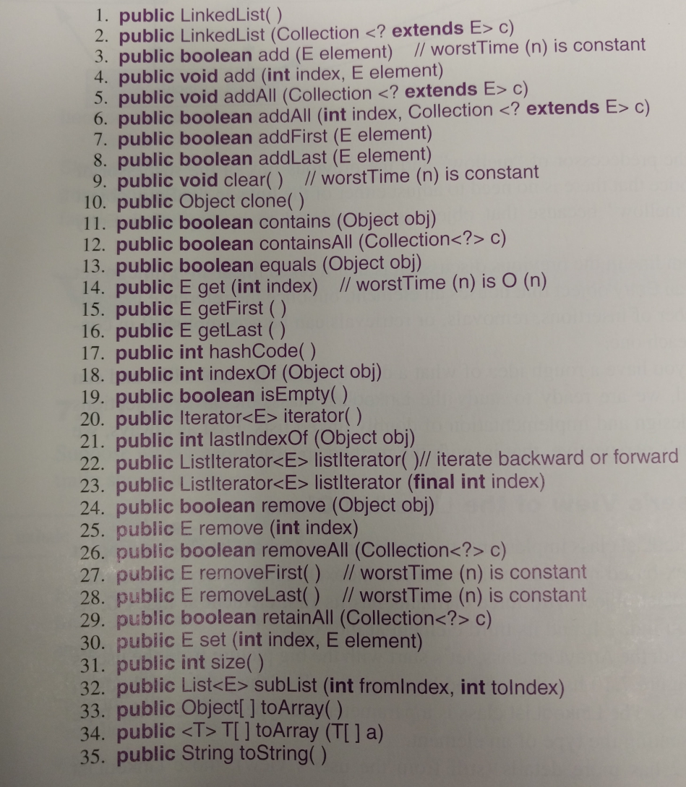
LinkedList Methods

Slide 26
public boolean add(E element)
O(1)
ArrayList was O(n)
Adds to the back of the list.
LinkedList<String> fruits = new LinkedList<String>();
fruits.add(“apples”);
fruits.add(“grapes”);
fruits.add(“oranges”);
fruits.add(“kiwis”);
“apples”,”grapes”,”oranges”,”kiwis”

Slide 27
public E get(int index)
O(n)
ArrayList get is O(1)
List accesses are time expensive!
fruits.get(1) → “grapes”

Slide 28
public E set(int index, E element)
O(n)
ArrayList set is O(1)
Still have to conduct “get” then alter the contents
fruits.set(1,”bananas”) → “bananas”

Slide 29
LinkedList Iterators
Essential to using LinkedLists
No random access
Bidirectional
ListItr class
private
accessed by LinkedList methods
creates and returns an iterator for a linkedlist

Slide 30
LinkedList Iterators
public ListIterator<E> listIterator();
ListIterator<String> itr1 = fruits.listIterator();
itr1 is a listItr object (class) descended from ListIterator(interface)
can move forwards and backwards

Slide 31
LinkedList Iterators
public ListIterator<E> listIterator(final int index);
ListIterator<String> itr2 = fruits.listIterator(2);
itr2 is created pointing at index 2 in the list

Slide 32
LinkedList Iterators
Iterating Forwards
hasNext()/next() or enhanced-for
while(itr1.hasNext()){
System.out.println(itr1.next());
}
for(String s: fruits){
System.out.println(s);
}
→“apples”,”bananas”,”oranges”,”kiwis”

Slide 33
LinkedList Iterators
Iterating Backwards
hasPrevious()/previous()
while(itr2.hasPrevious()){
System.out.println(itr2.previous());
}
→“bananas”, “apples”
itr2 was positioned at index 2, so it can move backward
If the same was called for itr1, positioned at index 0, hasPrevious() would be false

Slide 34
LinkedList Iterators – next vs previous
next() gives the current element then advances to the next index
previous() retreats to the previous index then gives the element at the retreated-to position

Slide 35
LinkedList Iterators –previous
Iterating backwards across a whole list requires starting beyond the list
ListIterator itr = fruits.listIterator(fruits.size());
//fruits.size() is the largest index +1
while(itr.hasPrevious()){
System.out.println(itr.previous());
}
→“kiwis”,”oranges”,”bananas”,”apples”

Slide 36
LinkedList Iterators – add
The iterator object can add Entries to the list
It puts them where the iterator is currently pointing
ListIterator<String> itr = fruits.listIterator();
while(itr.hasNext()){
itr.next();
itr.add(“pears”);
}

Slide 37
LinkedList Iterators – add
The iterator object can add Entries to the list
It puts them where the iterator is currently pointing
ListIterator<String> itr = fruits.listIterator();
while(itr.hasNext()){
itr.next();
itr.add(“pears”);
}
→“apples”,”pears”,”bananas”,”pears”,”oranges”,”pears”,
”kiwis”,”pears”

Slide 38
LinkedList Iterators – remove
The iterator object can remove Entries to the list
It removes the Entry returned by the most recent call to next/previous
ListIterator<String> itr = fruits.listIterator(1);
while(itr.hasNext()){
itr.next();
itr.remove();
if(itr.hasNext()){itr.next();}
}

Slide 39
LinkedList Iterators – remove
The iterator object can remove Entries to the list
It removes the Entry returned by the most recent call to next/previous
ListIterator<String> itr = fruits.listIterator(1);
while(itr.hasNext()){
itr.next();
itr.remove();
if(itr.hasNext()){itr.next();}
}
→“apples”,”bananas”,”oranges”,”kiwis”

Slide 40
LinkedList Iterators – set
The iterator object can modify Entries in the list
It removes the Entry returned by the most recent call to next/previous and replaces it with the input parameter
ListIterator<String> itr = fruits.listIterator();
while(itr.hasNext()){
String aFruit = itr.next();
char first = aFruit.toUpperCase().charAt(0);
aFruit=first+aFruit.substring(1);
itr.set(aFruit);
}

Slide 41
LinkedList Iterators – set
The iterator object can modify Entries in the list
It removes the Entry returned by the most recent call to next/previous and replaces it with the input parameter
ListIterator<String> itr = fruits.listIterator();
while(itr.hasNext()){
String aFruit = itr.next();
char first = aFruit.toUpperCase().charAt(0);
aFruit=first+aFruit.substring(1);
itr.set(aFruit);
}
→“Apples”,”Bananas”,”Oranges”,”Kiwis”

Slide 42
LLIterator.java

Slide 43
Under the Hood - LinkedList Fields
public class LinkedList<E> extends AbstractSequentialList<E>,
implements List<E>,
Clonable, Serializable
private transient int size=0;
private transient Entry<E> header=new Entry<E>
(null,null,null);

Slide 44
Under the Hood - LinkedList Fields
private static class Entry<E>{
E element;
Entry<E> next;
Entry<E> previous;
Entry(E element, Entry<E> next,
Entry<E> previous){
this.element=element;
this.next=next;
this.previous=previous;
}

Slide 45
LinkedList header field
Header is created as a dummy entry
element is always null
pointed at by last entry’s next field
next points to the first entry in the list
previous points to the last entry in the list

Slide 46
Under the Hood - Two Parameter add method
public void add(int index,E element)
First find a reference to the Entry at index
search backwards or forwards depending if index<size/2
Then, create a new entry with element
Next, set newEntry.previous.next to newEntry
Set newEntry.next.previous to newEntry
Increment size

Slide 47
Simple LinkedList Example
LLExample.java

Slide 48
Conclusion
LinkedLists have:
Constant time inserts and deletes
Linear time searches/accesses
No predefined size
linked storage
If the program requires iterating and making insertions/deletions during the iterations, LinkedLists are best
If the program requires accessing and modifying entries at varying indexes, ArrayLists are best

Slide 49
HW3 Assign

